Slide 1
AN INTRODUCTION TO NEURAL NETWORKS
CMP 414 & 765 Artificial Intelligence
Liang Zhao
CUNY Lehman College

Slide 2
OUTLINE
What are artificial neural networks?
How to construct an artificial neural network?
An XOR Example
Training method: Backpropagation
Discussion

Slide 3
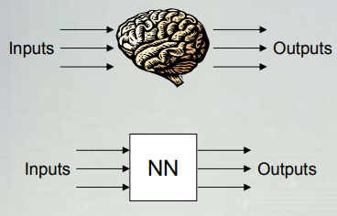
WHAT ARE ARTIFICIAL NEURAL NETWORKS?
An extremely simplified model of the brain
Transforms inputs into outputs to the best of its ability.

Slide 4
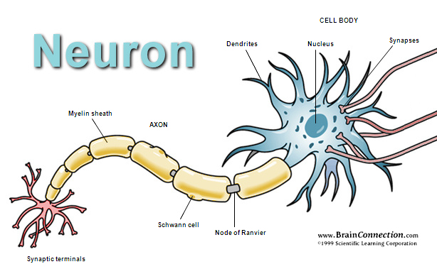
A NEURON
Dendrites: receive impulses from other cells and transmit them to the cell body.
Soma (or cell body): combines the impulses received and triggers action on the axons.
Axons: the long thread-like part of a neuron that impulses are sent to other cells.

Slide 5
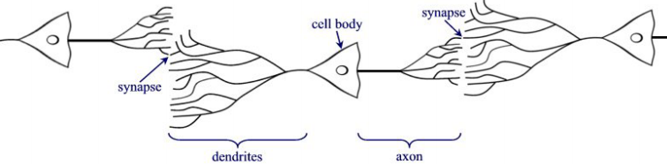
NEURON NETWORKS
Composes of many neurons that cooperate to perform the desired function.

Slide 6
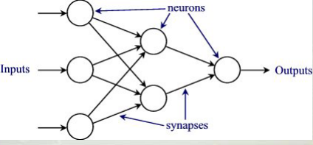
ARTIFICIAL NEURON NETWORKS (ANN)
Composes of many neurons that cooperate to perform the desired function.

Slide 7
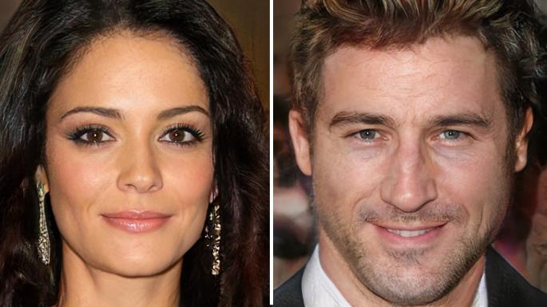
WHAT ARE NEURAL NETWORKS USED FOR?
Image Processing
Image classification
Face recognition
Object detection
Image segmentation
Artificially generated video

Slide 8
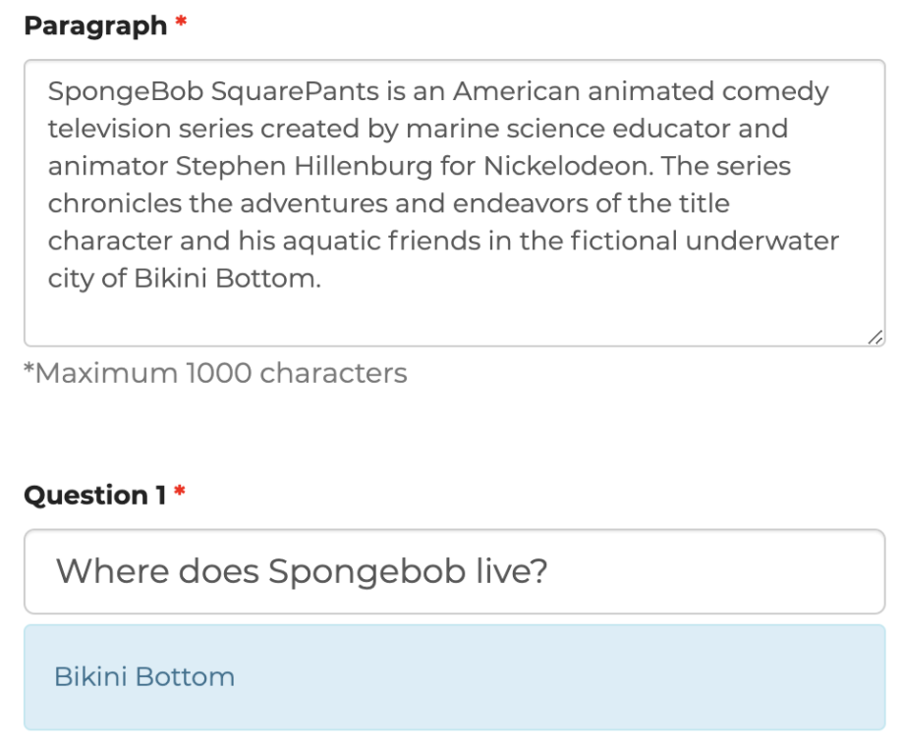
WHAT ARE NEURAL NETWORKS USED FOR?
Natural Language Processing
Translation
Sentiment analysis
Text summarization
Machine Q & A
Text Generation

Slide 9

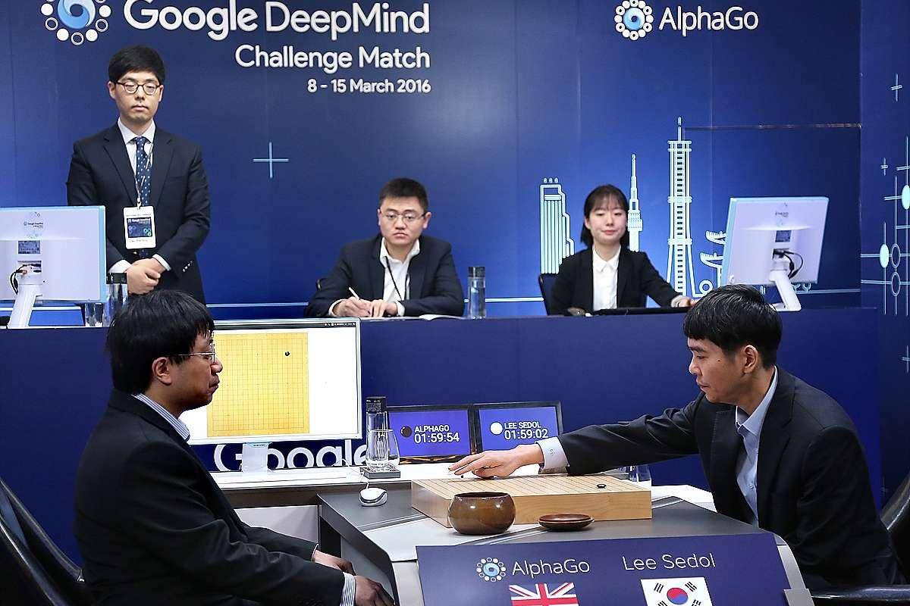
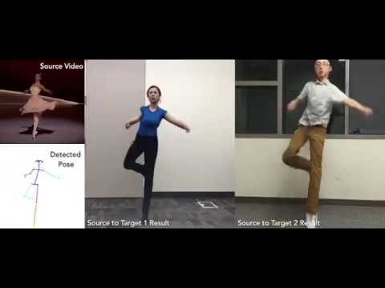
WHAT ARE NEURAL NETWORKS USED FOR?
Art
Music
Game
Everybody Dance Now

Slide 10
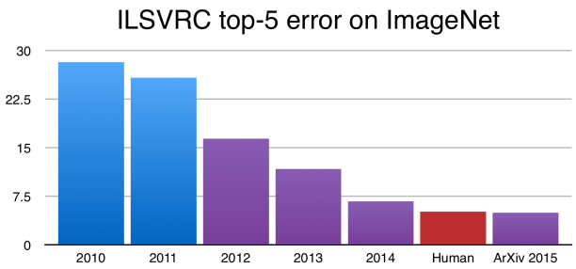
WHY USE NEURAL NETWORKS?
Universal approximation property (Cybenko, 1989)
Any continuous function or indicator function can be approximated arbitrarily well by a neural network model.
State-of-the-art results in many important applications

Slide 11
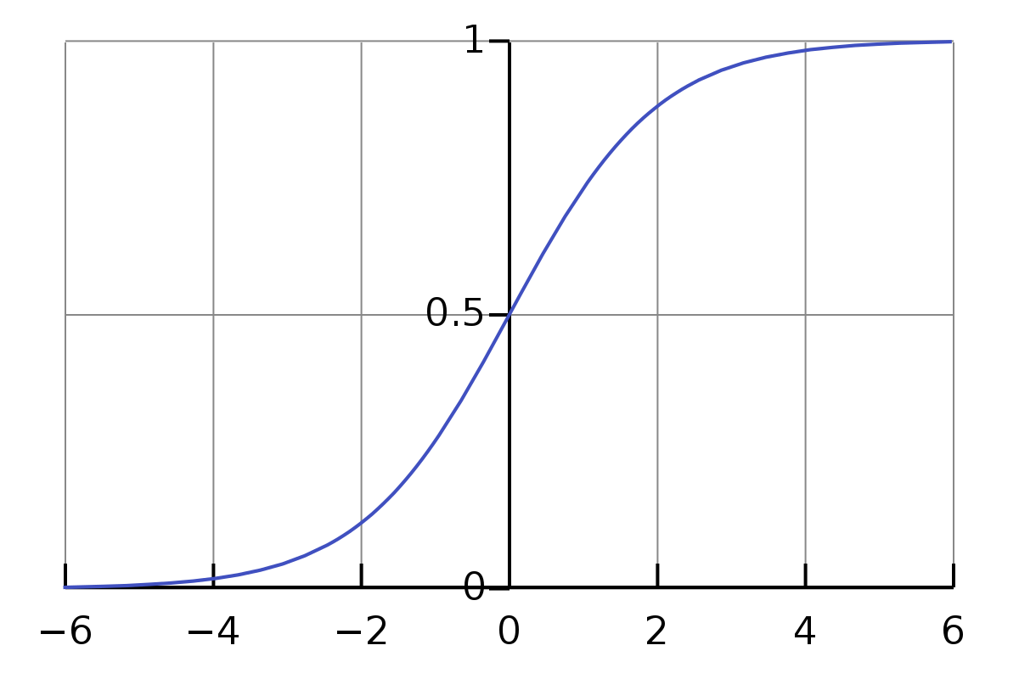
ARTIFICIAL NEURON: ACTIVATION FUNCTIONS
Applied to the weighted sum of the inputs to produce the output.
Choice 1: logistic function (sigmoid function)
Smooth, continuous, and monotonically increasing. (What’s its derivative?)
Two asymptotes: y=0 and y=1.
Function values are very close to an asymptote for x << 0 and x >> 0.

Slide 12
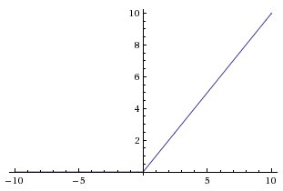
ACTIVATION FUNCTIONS
Choice 2: Rectified Linear Unit (ReLU)
ReLU(t) = max(0, t)
Very simple to evaluate
Derivative exists everywhere except for 0
Derivative is either 0 or 1

Slide 13
HOW TO CONSTRUCT A NEURAL NETWORK?
Input layer: for each input feature, create a node to read its value.
First hidden layer: create n₁ nodes in this layer. Number of nodes is determined by the researcher.
Input of each node: a weighted sum of previous nodes plus a bias.
Activation function: based on the weighted sum, decide whether to trigger reaction.
Output: evaluation of the activation function
Second hidden layer, ...
Output layer: create n2 nodes in this layers, one node for each output feature.
Input: a weighted sum of previous node outputs plus a bias.
Transformation (optional): convert the values to a proper model output.

Slide 14
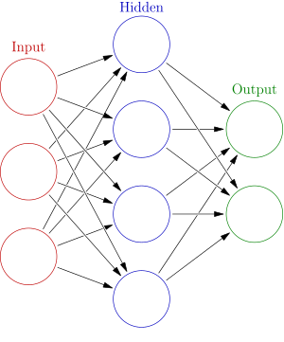
HOW TO CONSTRUCT A NEURAL NETWORK?
Circles: nodes or neurons that represent activation functions
Columns of circles: layers of a neural network
Arrows: inputs of each node (a weight is attached to each arrow)

Slide 15
EXAMPLE: XOR FUNCTION
Exclusive or (XOR) function is a logical operation that outputs true only when inputs differ (one is ture, other is false)
XOR truth table
Input |  | Output
A | B
0 | 0 | 0
0 | 1 | 1
1 | 0 | 1
1 | 1 | 0

Slide 16
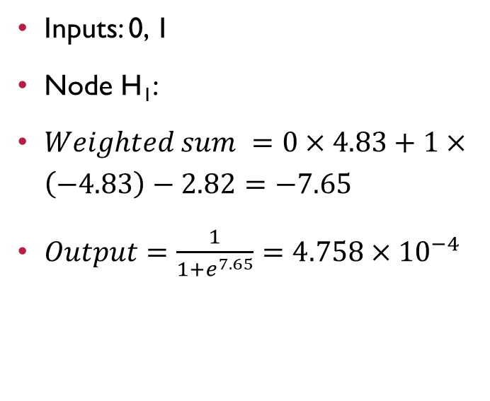
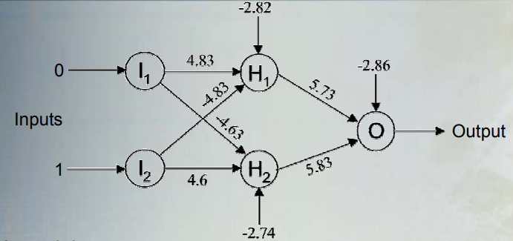
EXAMPLE: XOR FUNCTION

Slide 17
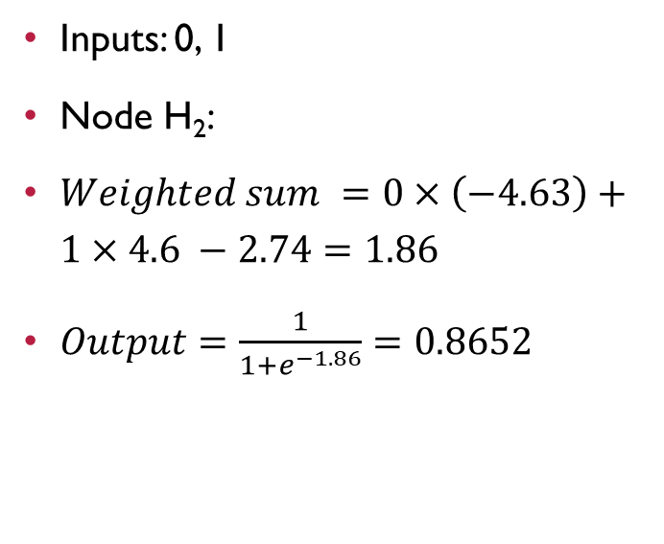
EXAMPLE: XOR FUNCTION

Slide 18
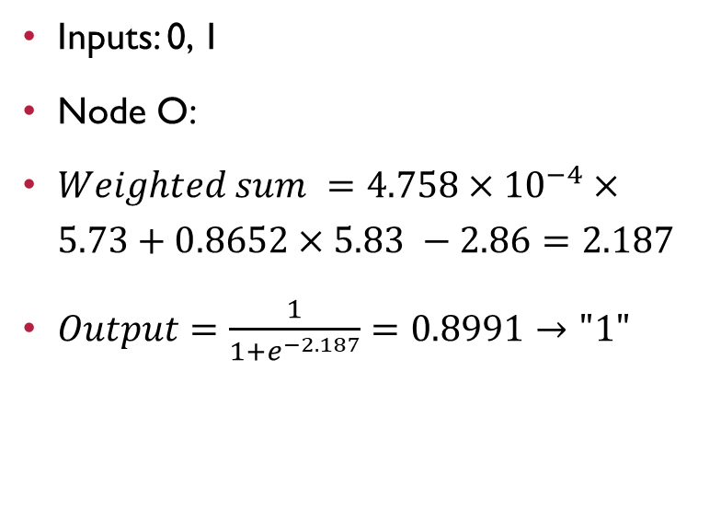
EXAMPLE: XOR FUNCTION
0.8991

Slide 19
EXAMPLE: XOR FUNCTION
Inputs: 1, 0 ?

Slide 20
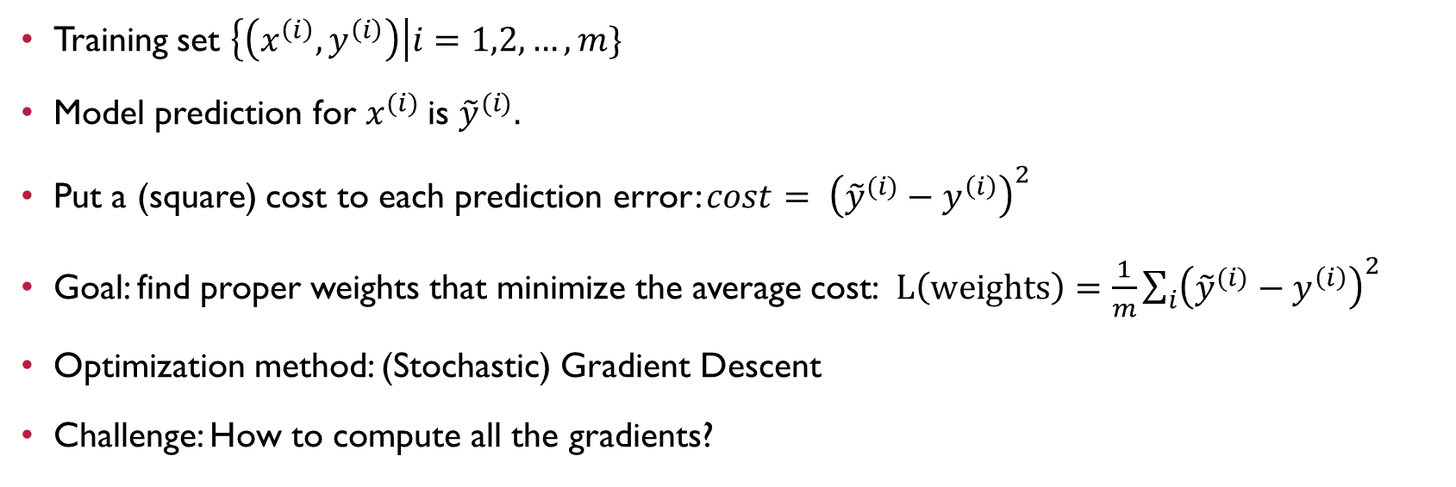
TRAINING A NEURAL NETWORK

Slide 21
BACKPROPAGATION
Short for “backward propagation of errors”
An algorithm for gradient descent of artificial neural networks
Calculates the gradient (all partial derivatives) of the cost function with respect to the weights.
Based on the chain rule for differentiating composition of functions, the algorithm computes partial derivatives of weights in the last layer first, then it computes partial derivatives for the second-to-last layer, and so on. Hence it is called “backpropagation”.

Slide 22
DISCUSSION: WHY USE NEURAL NETWORKS?
NNs outperforms other ML techniques on large and complex problems.
The tremendous increase in computing power makes it possible to train large neural networks in a reasonable amount of time.
The training algorithms have been improved.
Some theoretical limitations of NNs have turned out to be benign in practice.

Slide 23
WHY NOT USE NEURAL NETWORKS?
Huge number of parameters: slow to use, prone to overfitting.
Black box model: hard to understand the learned function
High Variance and lack of performance guarantee

Slide 24
Neural Network Playground
Please go to the neural network playground, and use the tools to construct a simple neural network.

Slide 25
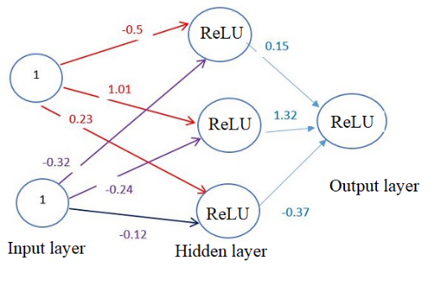
Example: RELU Activation
The figure on the right shows a neural network with one hidden layer with ReLU as activation function.
Given input (1, 1) and weights of the network, compute the input and output of each neuron in the hidden layer and the output layer (assume that all biases are zero).

